Slide 1
Applied Machine Learning SS/SE ZG568
Dr. Sugata Ghosal
CSIS Off-Campus Faculty
BITS Pilani
Notes:
Welcome to the applied machine learning course.

Slide 2
Course Content
No | Title of the Module | References
M1 | Introduction to Machine Learning What and Why Applications of Machine Learning Types of Machine Learning Challenges in Machine Learning | T1: Chapter 1 R2
M2 | Big Picture: End-to-end Machine Learning 2.1. Framing the ML Problem 2.2. Data Types, Pre-processing, Visualization and Analysis | T1: Chapter 2 T2: Chapter 2-3
M3 | Big Picture: End-to-end Machine Learning Model Selection and Training Evaluation Machine Learning Pipeline | T1: Chapter 2-3 T2: Chapter 2-3
M4 | Linear Prediction Models Linear Regression Gradient Descent and Variants Regularization Bias Vs. Variance | T1: Chapter 4 T2: Appendix D
M5 | Classification Models I Logistic Regression Support Vector Machines Naïve Bayes Comparative Analysis | T1: Chapter 4, 5 T2: Chapter 5, Section 3

Slide 3
Course Content
No | Title of the Module | References
M6 | Classification Models II 6.1 Decision Tree 6.2 Challenges with Decision tree 6.3 Ensembles 6.3.1. Bagging 6.3.2. Boosting 6.3.3. Random Forest | T1: Chapter 6-7 T2: Chapter 4, 5.6
M7 | Unsupervised Learning 7.1. Dimensionality reduction and feature extraction 7.2 K-means Clustering 7.4 EM Algorithm 7.5 Applications | T1: Chapter 8-9 T2: Chapter 8
M8 | Neural Networks 8.1. Perceptrons and Delta Rule 8.2. Multi-Layer Perceptrons and Backpropagation 8.3. Deep Learning | T1: Chapter 10-11 T2: Chapter 5.4
M9 | Deep Networks 9.1. Convolutional Neural Network 9.2. Recurrent Neural Network 9.3. Applications in Image and Text Processing | T1: Chapter 14, 15 Lecture Slides
M10 | FAccT Machine Learning 10.1. Bias and Fairness 10.2. Interpretability and Transparency 10.3. Robustness and Adversarial Attacks | R1

Slide 4
Text Books
T1 | Aurelien Geron, “Hands-On Machine Learning with Scikit-Learn, Keras and Tensorflow”, O’Reilly, 2020
T2 | P-N Tan, M. Steinbach, Vipin Kumar, “Introduction to Data Mining”, 2016, Pearson
R1 | Christoph Molner, “Interpretable Machine Learning”, 2020, https://christophm.github.io/interpretable-ml-book/
R2 | Pedro Domingos, “A Few Useful Things to Know About Machine Learning”, pp. 78-87, Communications of the ACM, vol. 55 no. 10, October 2012.

Slide 5
Introduction to Machine Learning
Dr. Sugata Ghosal
CSIS Off-Campus Faculty
BITS Pilani
Notes:
Welcome to the applied machine learning course.

Slide 6
In this segment
What is Machine Learning
Why Machine Learning
Connection with Other technical areas

Slide 7
What is Machine Learning (ML)?
What is Machine Learning
The science (and art) of programming computers so they can learn from data
More general definition
Field of study that gives computers the ability to learn without being explicitly programmed
Engineering-oriented definition
Algorithms that improve their performance P at some task T with experience E
A well-defined learning task is given by <P, T, E>
Traditional programming
Machine Learning
Computer
Data
Output
Computer
Data
Program
Output
Program

Slide 8
Defining the Learning Tasks
Improve on task T, with respect to performance metric P, based on experience E
Example 1
T: Playing checkers
P: Percentage of games won against an arbitrary opponent
E: Playing practice games against itself
Example 2
T: Recognizing hand-written words
P: Percentage of words correctly classified
E: Database of human-labeled images of handwritten words
Example 3
T: Driving on four-lane highways using vision sensors
P: Average distance traveled before a human-judged error
E: A sequence of images and steering commands recorded while observing a human driver.
Example 4
T: Categorize email messages as spam or legitimate.
P: Percentage of email messages correctly classified.
E: Database of emails, some with human-given labels

Slide 9
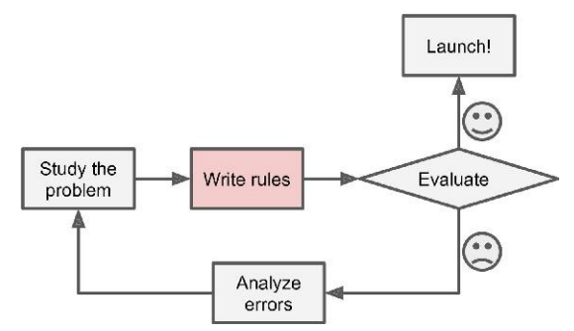
Traditional Approach to Spam Filtering
Spam typically uses words or phrases such as “4U,” “credit card,” “free,” and “amazing”
Solution
Write a detection algorithm for frequently appearing patterns in spams
Test and update the detection rules until it is good enough.
Challenge
Detection algorithm likely to be a long list of complex rules
hard to maintain.

Slide 10
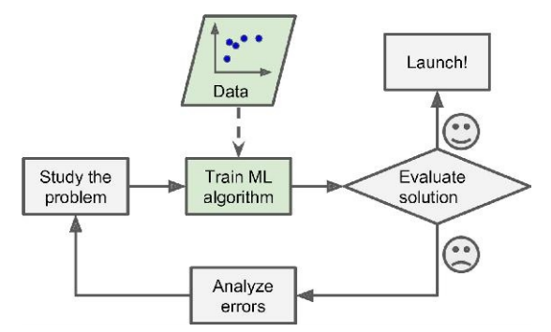
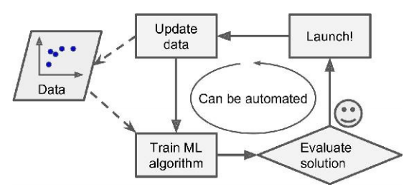
Machine Learning Approach
Automatically learns phrases that are good predictors of spam by detecting unusually frequent patterns of words in spams compared to “ham”s
The program is much shorter, easier to maintain, and most likely more accurate.

Slide 11
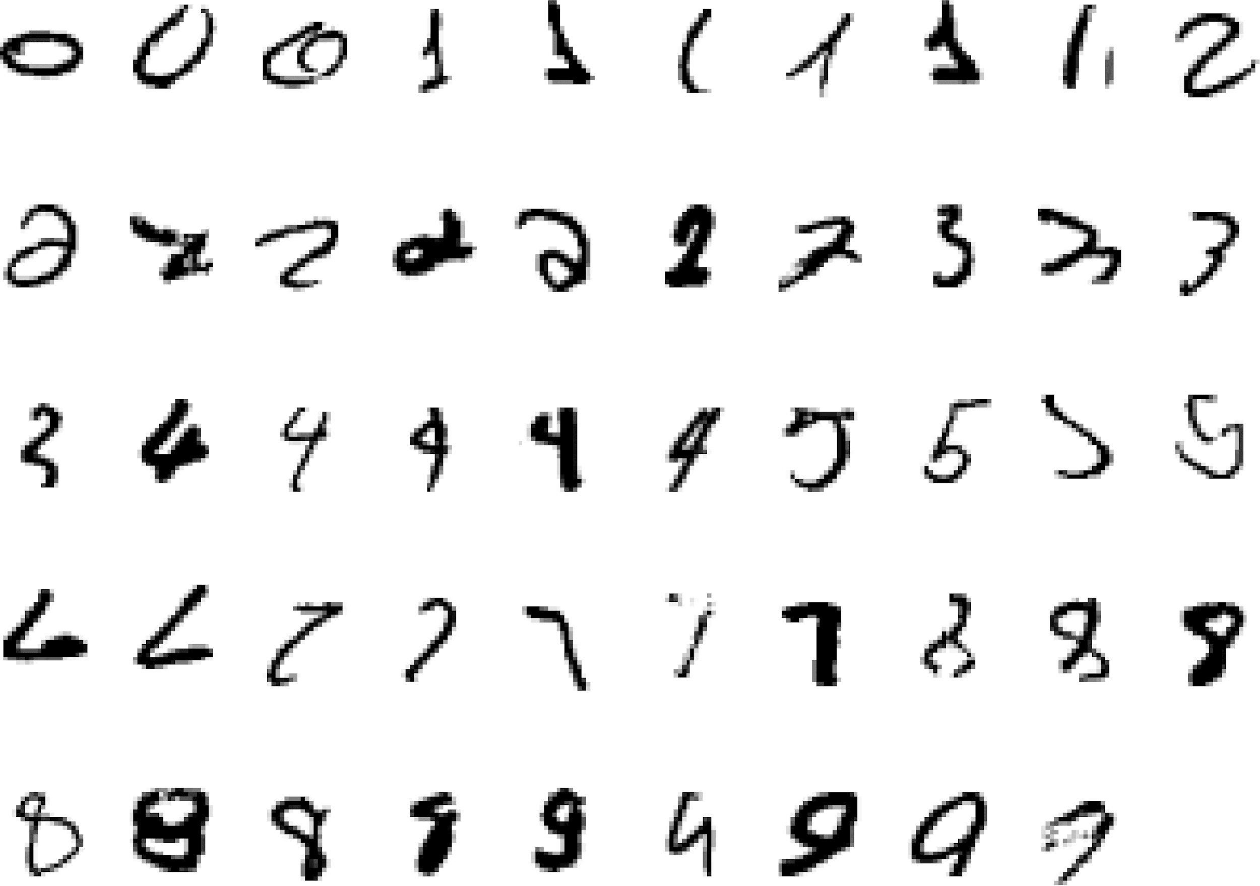
A Classic example of ML Task
It is very hard to say what makes a “2”
Actually a “3” not a “2”
All “2”s
A “3”
A “7”

Slide 12
More ML Usage Scenarios
Tasks that are best solved by using a learning algorithm
Recognizing Patterns in images, text
Facial identities or facial expressions
Handwritten or spoken words
Medical images
Recognizing Anomalies in structured dataset
Unusual credit card transactions
Unusual patterns of sensor readings in a nuclear power plant
Prediction from time series data
Future stock prices or currency exchange rates
Generating new Patterns
Generating images or motion sequences

Slide 13
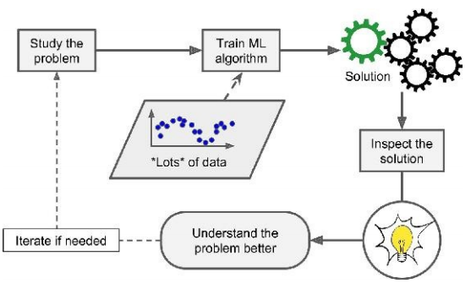
Machine Learning Helps Human Learning
Sometimes reveals unsuspected correlations / new trends leading to better understanding
Data Mining
Applying ML techniques to dig into large amounts of data can help discover patterns

Slide 14

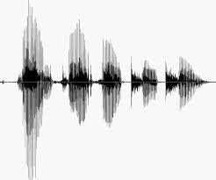
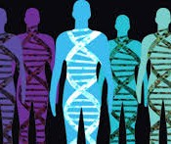
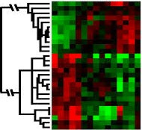
When to Use Machine Learning
ML Usage Scenarios
Problems for which existing solutions require a lot of hand-tuning or long lists of rules
Complex problems for which there is no good solution at all using a traditional approach
Human rationale cannot be codified
Changing environments
Get insights about complex problems and large amounts of data

Slide 15
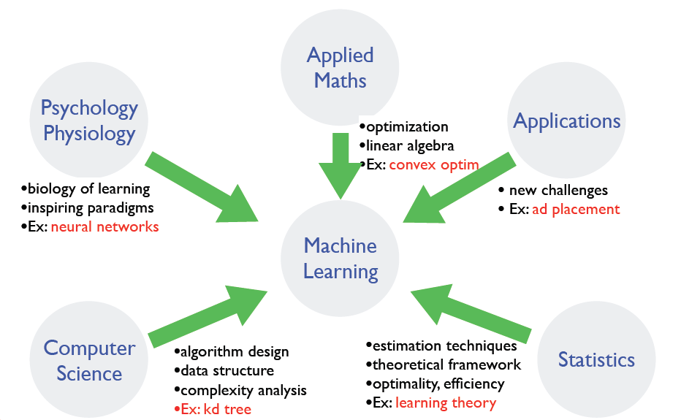
Where does ML fit in?

Slide 16
Applications
Dr. Sugata Ghosal
CSIS Off-Campus Faculty
BITS Pilani

Slide 17
In this segment
Types of Applications
Application Domains
State of the Art Applications

Slide 18
Two Classes of Application
Assign/Predict an object/event to an element of a given set
If set of integers, then it is a classification problem
If set of reals, then it is a regression problem
Predict a sequence of steps to achieve a goal

Slide 19
Application Domains
Internet
Computational biology
Finance
E-commerce
Space exploration
Robotics
Information extraction
Social networks
Software engineering
System management
Creative Arts

Slide 20
Example: Classification
Assign object/event to one of a given finite set of categories
Medical Diagnosis
Credit card applications or transactions
Fraud detection in e-commerce
Worm detection in network packets
Spam filtering in email
Recommended articles in a newspaper
Recommended books, movies, music, or jokes
Financial investments
DNA sequences
Spoken words
Handwritten letters
Astronomical images

Slide 21
Example: Planning, Control, Problem Solving
Performing actions in an environment in order to achieve a goal
Playing checkers, chess, or backgammon
Balancing a pole
Driving a car or a jeep
Flying a plane, helicopter, or rocket
Controlling an elevator
Controlling a character in a video game
Controlling a mobile robot

Slide 22


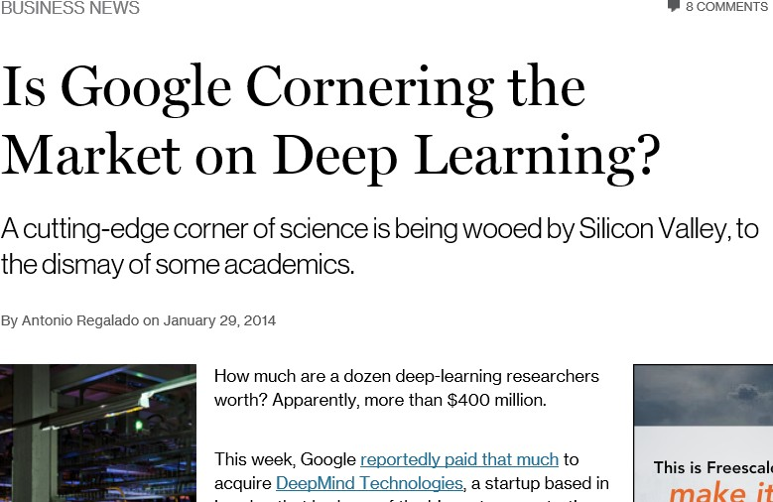
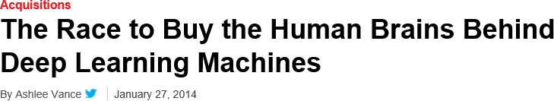
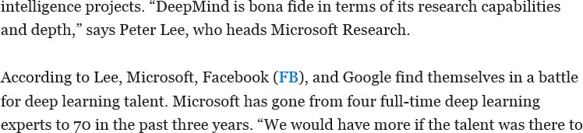
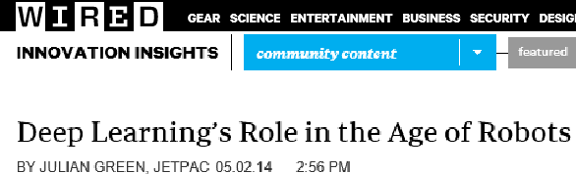
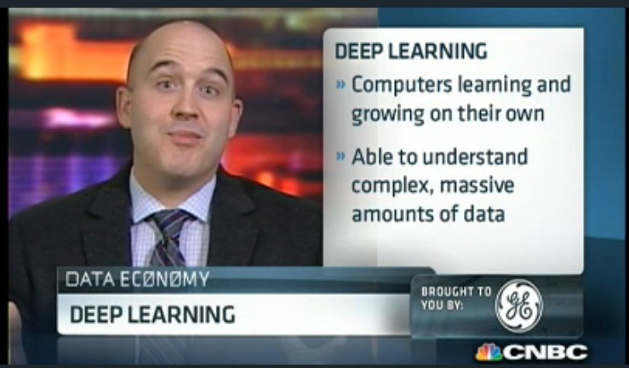
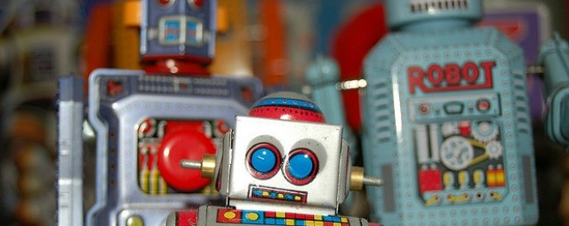
Deep Learning in Headlines

Slide 23
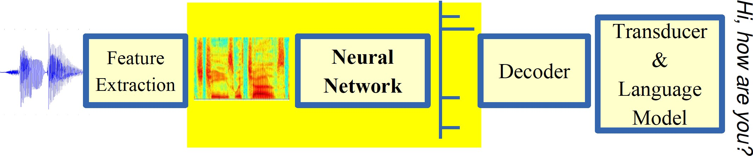
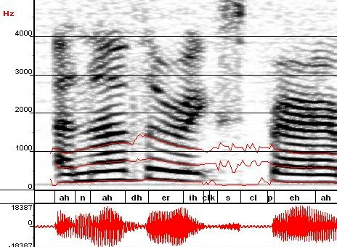
Breakthrough in Automatic Speech Recognition
ML used to predict of phone states from the sound spectrogram
Deep learning has state-of-the-art results
# Hidden Layers | 1 | 2 | 4 | 8 | 10 | 12
Word Error Rate % | 16.0 | 12.8 | 11.4 | 10.9 | 11.0 | 11.1
Baseline (Gaussian Mixture Model) performance = 15.4%
[Reference: Zeiler et al., “On rectified linear units for speech recognition” ICASSP 2013]

Slide 24
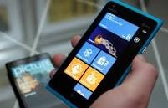
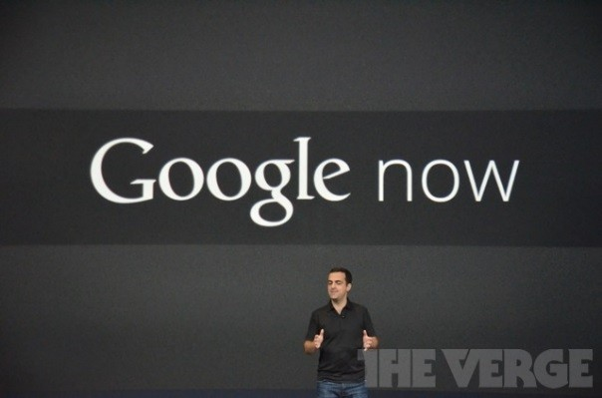
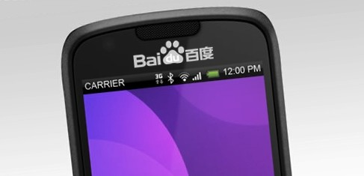
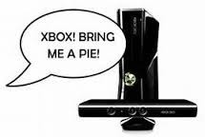



Impact of Deep Learning in Speech Technology

Slide 25
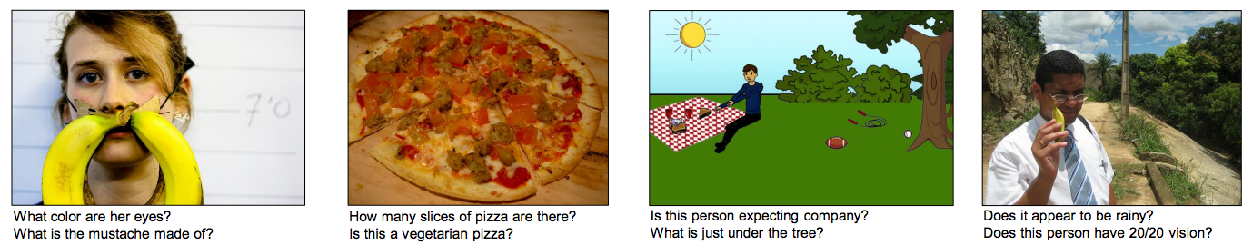
Visual Question Answering
Answering questions about images

Slide 26
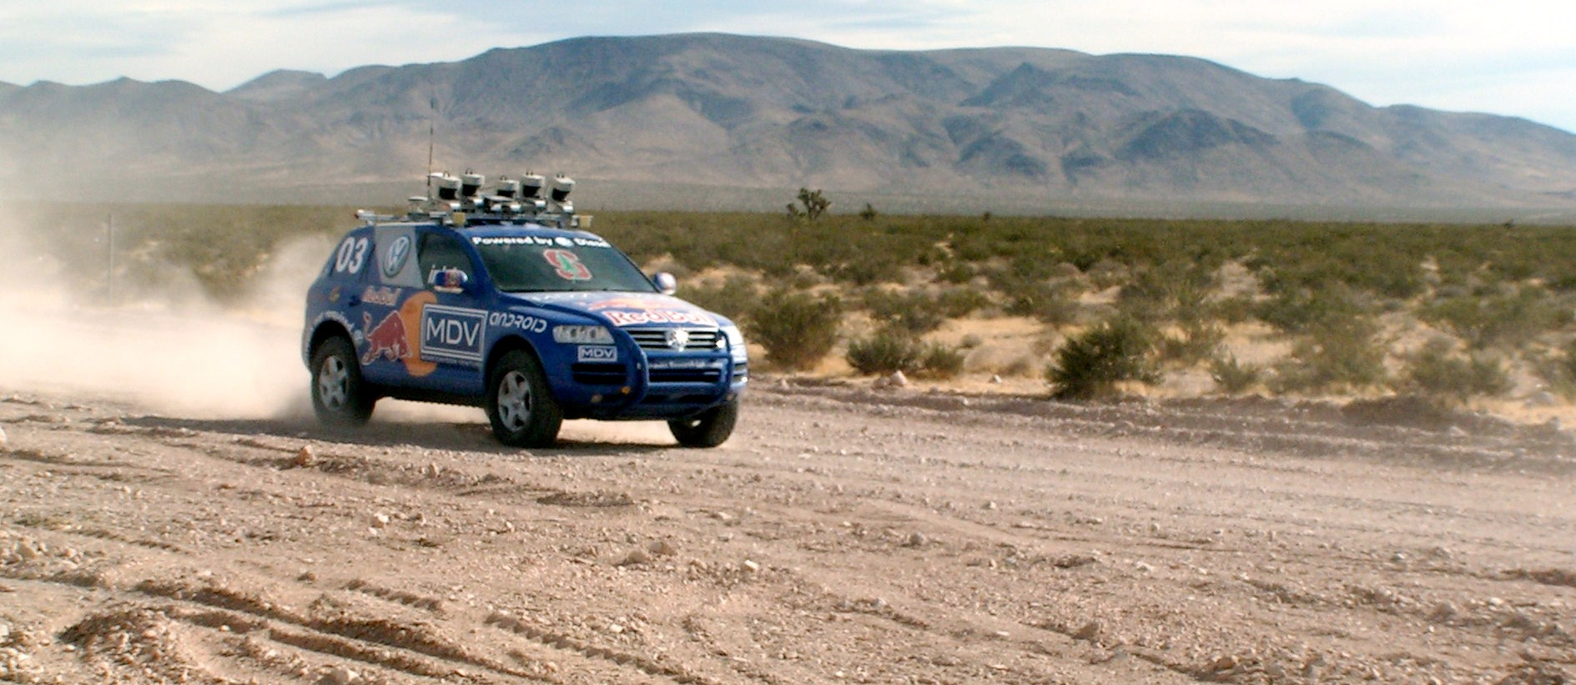
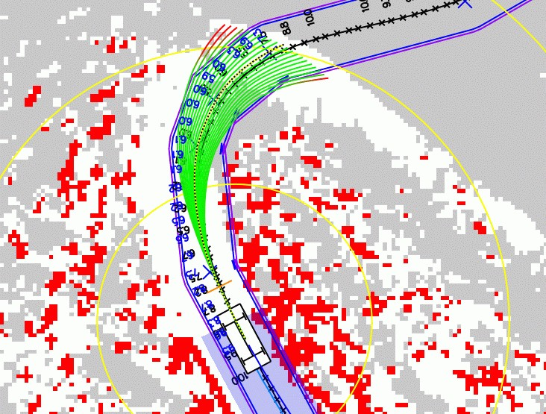
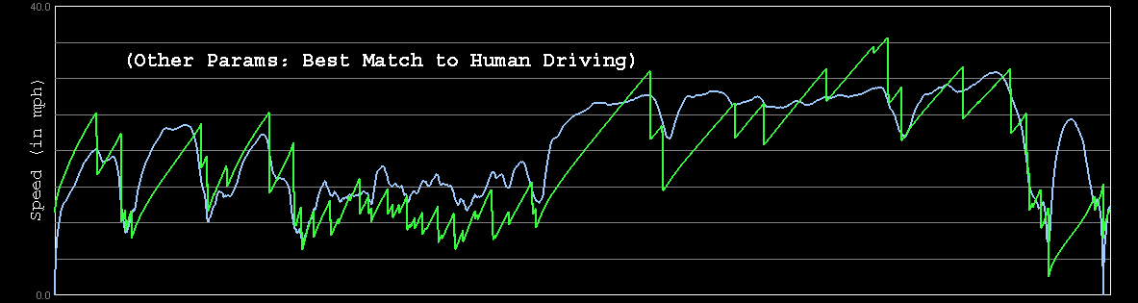

Autonomous Car Technology
Path Planning
Laser Terrain Mapping
Learning from Human Drivers
Sebastian
Adaptive Vision
Stanley

Slide 27
Contemporary ML Based Solutions
Optical Character Recognition
Product Image Classification on a production line
Detecting tumors in brain scans
Information extraction from document images
Categorization of news articles
Flagging offensive comments in discussion forums
Document summarization
Chatbots / Voice activated App
Detecting Credit Card Fraud
Customer Segmentation
Recommendation System for products, movies, news
Forecasting company revenue

Slide 28
Types of Machine Learning
Dr. Sugata Ghosal
CSIS Off-Campus Faculty
BITS Pilani

Slide 29
In this segment
Supervised Vs. Unsupervised Vs. Semi-Supervised Vs. Reinforcement
Batch Vs. Online Learning
Instance Based Vs. Model Based Learning

Slide 30
Types of Learning
Based on level of supervision
Supervised (inductive) learning
Given: training data, desired outputs (labels)
Unsupervised learning
Given: training data only (without desired outputs)
Semi-supervised learning
Given: training data and a few desired outputs
Reinforcement learning
Given: rewards from sequence of actions

Slide 31




Supervised Learning: Regression
Given (x₁, y₁), (x₂, y₂), ..., (x_{n}, y_{n})
Learn a function f (x) to predict y given x
– y is real-valued
9
8
7
6
5
4
3
2
1
0
1970 1980
September Arctic Sea Ice Extent (1,000,000 sq km)
1990
2000
2010
2020
Year Number

Slide 32










Supervised Learning: Classification
Given (x₁, y₁), (x₂, y₂), ..., (x_{n}, y_{n})
Learn a function f (x) to predict y given x
– y is categorical
Cancer (benign / malignant)
y=1 (malignant)
y=0 (benign)
Tumor Size (x)

Slide 33








Supervised Learning: Classification
Given (x₁, y₁), (x₂, y₂), ..., (x_{n}, y_{n})
Learn a function f (x) to predict y given x
– y is categorical
Cancer (benign / malignant)
1 (malignant)
0 (benign)
Tumor Size
Learnt classifer
If x>T, malignant else benign
Predict benign
Predict malignant
x=T

Slide 34










Increasing Feature Dimension
x can be multi-dimensional
– Each dimension corresponds to an attribute
Clump Thickness
Uniformity of Cell Size
Uniformity of Cell Shape
…
Age
Tumor Size

Slide 35
Example: Supervised Learning Techniques
Linear Regression
Logistic Regression
Naïve Bayes Classifiers
Support Vector Machines (SVMs)
Decision Trees and Random Forests
Neural networks

Slide 36















Unsupervised Learning
Given x₁, x₂, ..., x_{n} (without labels)
Output hidden structure behind the x’s
e.g., clustering

Slide 37
Example: Unsupervised Learning Techniques
Clustering
k-Means
Hierarchical Cluster Analysis
Expectation Maximization
Visualization and dimensionality reduction
Principal Component Analysis (PCA)
Kernel PCA
Locally-Linear Embedding (LLE)
t-distributed Stochastic Neighbor Embedding (t-SNE)
Association rule learning
Apriori
Eclat

Slide 38
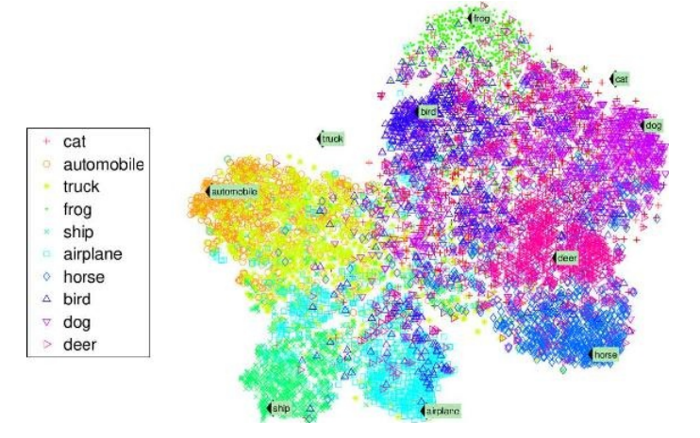
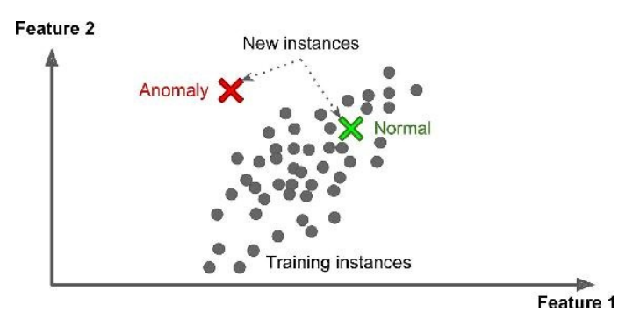
Data Visualization
Visualize 2/3D representation of complex unlabelled training data
Preserve as much structure as possible
e.g., trying to keep separate clusters in the input space from overlapping in the visualization
Understand how the data is organized
Identify unsuspected patterns.
frog
cat
bird
dog
truck
automobile
deer
horse
ship
airplane

Slide 39
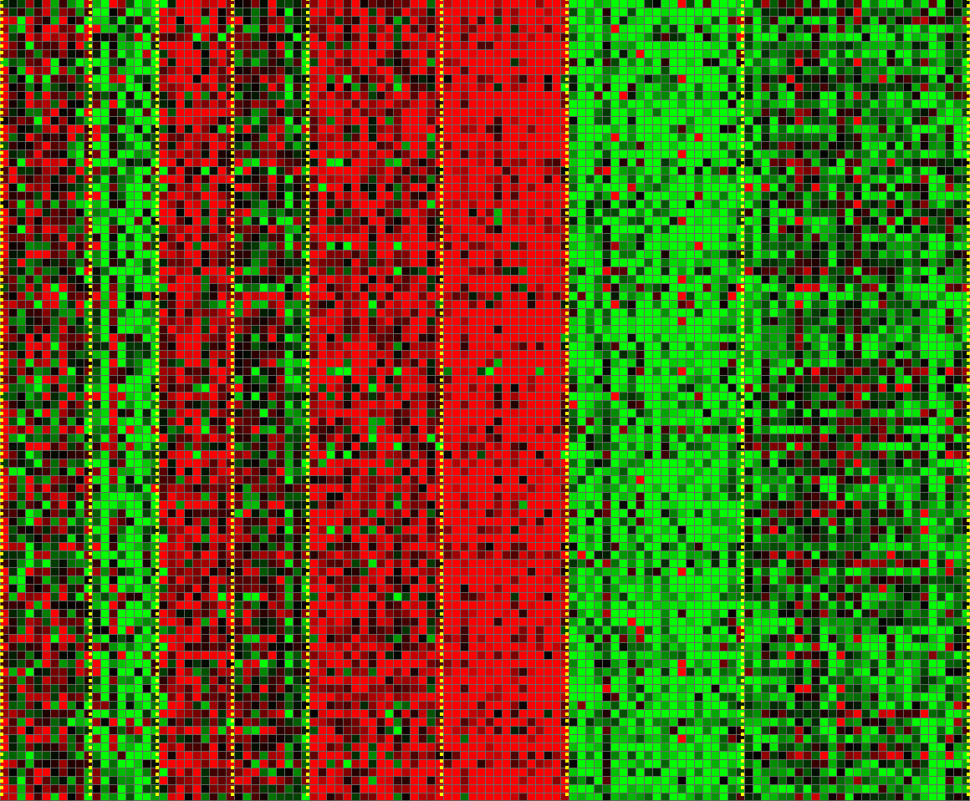
Applications: Unsupervised Learning
Genomics application: Group individuals by genetic similarity
Genes
Individuals

Slide 40
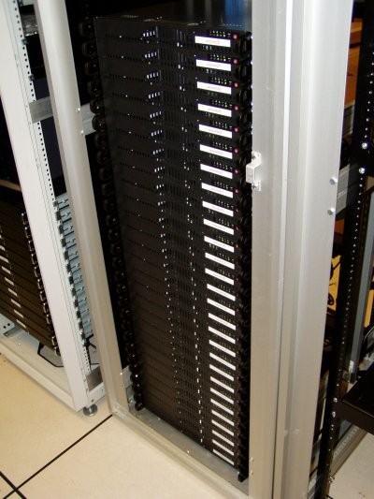
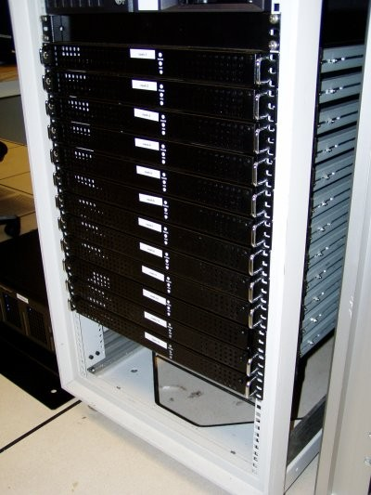





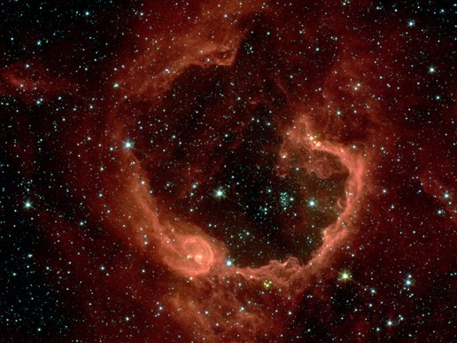



Applications: Unsupervised Learning
Organize computing clusters
Social network analysis
Market segmentation
Astronomical data analysis

Slide 41
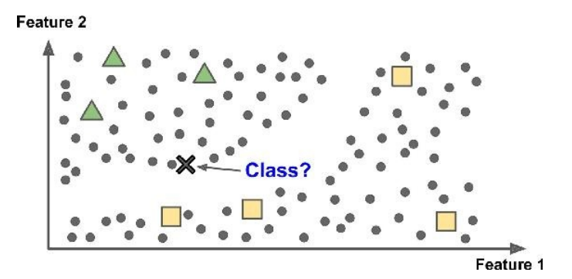
Semisupervised Learning
Partially labelled data – some labelled data and a lot of unlabelled data
Combines unsupervised and supervised learning algorithms
Photo hosting service, e.g., google photos

Slide 42
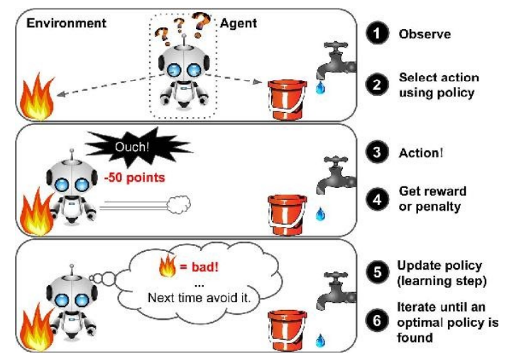
Reinforcement Learning
A learning agent
observes the state of the environment, select and perform actions
gets +ve or -ve rewards in return
learns the best strategy, aka a policy, to get the most reward over time.
policy is a mapping from states → actions
Examples:
Game playing, e.g., AlphaGo
Robot in a maze
Balance a pole on your hand

Slide 43
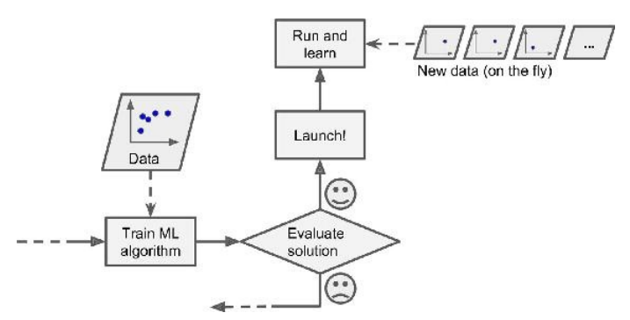
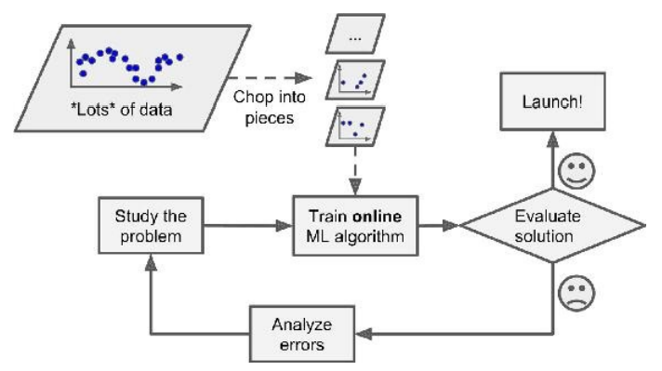
Types of Learning
Based on how training data is used
Batch learning
Uses all available data at a time during training
Mini Batch learning
Uses a subset of available at a time during training
Online (incremental) learning
Uses single training data instance at a time during training

Slide 44
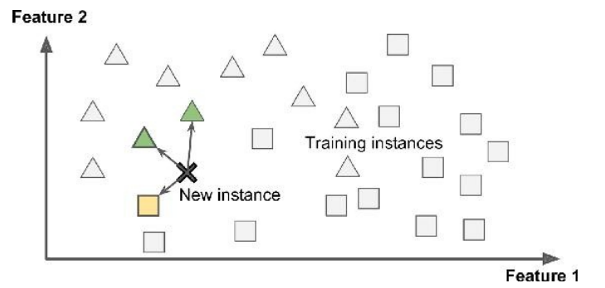
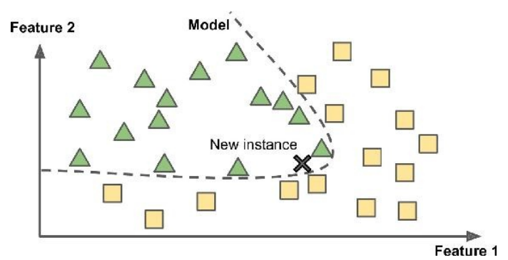
Types of Learning
Based on how training data is used
Instance Based Learning
compare new data points to known data points
Model Based learning
detect patterns in the training data and build a predictive model
Instance Based
Model Based

Slide 45
Challenges of Machine Learning
Dr. Sugata Ghosal
CSIS Off-Campus Faculty
BITS Pilani

Slide 46
In this segment
Training Data
Insufficient
Non representative
Poor Quality
Irrelevant attributes
Model Selection
Overfitting
Underfitting
Testing and Validation
Hyperparameters

Slide 47
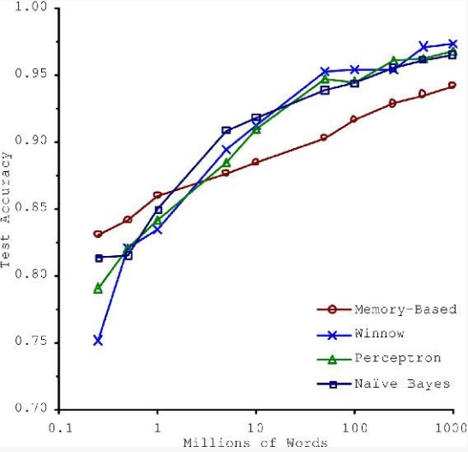
Insufficient Training Data
Consider trade-off Between Algorithm development & training data capture

Slide 48
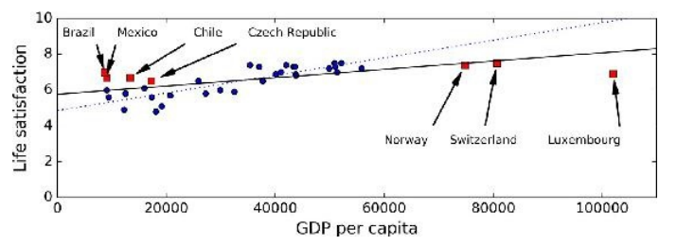
Non-representative Training Data
Training Data be representative of the new cases we want to generalize
Small sample size leads to sampling noise
Missing data over emphasizes the role of wealth on happiness
If sampling process is flawed, even large sample size can lead to sampling bias
missing data
available data

Slide 49
Data Quality
Cleaning often needed for improving data quality
Some instances have missing features
e.g., 5% of customers did not specify their age
Ignore the instances all together or the feature,
fill in the missing values
Train multiple ML models
Some instances can be erroneous, noisy or outliers
Human or machine generated
Identify, discard or fix manually, as appropriate

Slide 50
Irrelevant Features
Feature engineering needed for coming up with a good set of features
Feature selection
more useful features to train on among existing features.
Feature extraction
combine existing features to produce a more useful one.
Create new features by gathering new data

Slide 51
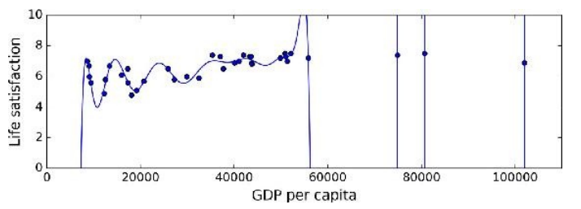
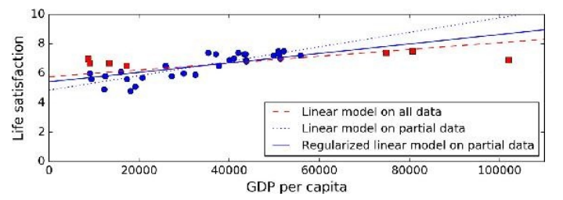
Model Selection
Overfitting or Underfitting
Overfitting leads to high performance in training set but performs poorly on new data
e.g., a high-degree polynomial life satisfaction model that strongly overfits the training data
Small training set or sampling noise can lead to model following the noise than the underlying pattern in the dataset
Solution: Regularization
Underfitting when the model is too simple to learn the underlying structure in the data
Select a more powerful model, with more parameters
Feed better features to the learning algorithm
Reduce regularization
Large slope
Smaller slope
High-order
polynomial

Slide 52
Testing and Validation
Performance of ML algorithms is statistical / predictive
Good ML algorithms need to work well on test data
But test data is often not accessible to the provider of the algorithm
Common assumption is training data is representative of test data
Randomly chosen subset of the training data is held out as validation set
aka dev set
Once ML model is trained, its performance is evaluated on validation data
Expectation is ML model working well on validation set will work well on unknown test data
Typically 20-30% of the data is randomly held out as validation data

Slide 53
Cross Validation
K-fold validation is often performed
To reduce the bias of validation set selection process
Often K is chosen as 10
aka 10 fold cross validation
10 fold cross validation involves
randomly selecting the validation set 10 times
model generation with 10 resulting training set
Evaluate the performance of each on that validation set
averaging the performance over the validation sets

Slide 54
Choice of Hyperparameters
Modern ML models often use a lot of model parameters
Known as hyperparameters
Model performance depends on choice of parameters
Each parameter can assume a number of values
Real numbers or categories
Exponential number of hyperparameter combinations possible
Best model correspond to best cross validation performance over the set of hyperparameter combinations
Expensive to perform
Some empirical frameworks available for hyperparameter optimization

Slide 55
Testing and Validation
x can be multi-dimensional
– Each dimension corresponds to an attribute
Clump Thickness
Uniformity of Cell Size
Uniformity of Cell Shape
…
Age
Tumor Size

Slide 56
Testing and Validation
x can be multi-dimensional
– Each dimension corresponds to an attribute
Clump Thickness
Uniformity of Cell Size
Uniformity of Cell Shape
…
Age
Tumor Size

Slide 57
Thank You!
In our next session: End to End ML

